Slide 1
Project 3 : Exploratory Data Analysis (EDA) for Real Estate Pricing
Gurpreet kaur
Submission Date: 14 Feb 2025

Slide 2
Introduction
Objective: The primary goal of this analysis is to explore real estate pricing trends and identify the key factors that influence
property values. Understanding these patterns can help buyers, sellers, and investors make informed decisions
based on data-driven insights.
Dataset Overview : The dataset contains real estate pricing data with various attributes that impact house prices. Key
features include:
Location: Neighborhood, proximity to schools, parks, and commercial areas.
Property Size: Total square footage, number of bedrooms and bathrooms.
Amenities: Presence of a swimming pool, garage, garden, or smart home features.
Market Trends: Historical price changes over time, economic influences, and seasonal fluctuations.
By analyzing these features, we can uncover patterns, correlations, and pricing trends to better understand real estate valuation.

Slide 3
Data Loading
Task:
Load the real estate pricing dataset into a Pandas DataFrame to facilitate easy manipulation and analysis. This step ensures that the data is structured properly for further exploration.
Library Used:
Pandas: A powerful Python library used for data manipulation and analysis.
Steps Taken:
Imported the necessary libraries (pandas).
Loaded the dataset from a CSV/Excel file into a Pandas DataFrame.
Displayed the first few rows to verify successful loading.
Key Takeaway:
The dataset was successfully imported and is now ready for cleaning and analysis.
Initial verification ensured correct column names, data types, and structure.

Slide 4
Data Cleaning
Challenges:
Cleaning the dataset is essential for ensuring accurate analysis. The main challenges encountered were:
Missing Values: Some records had incomplete data for key features like price, square footage, or amenities.
Duplicate Entries: Multiple instances of the same property were present, leading to redundancy.
Anomalies: Unrealistic values such as negative prices, extremely high square footage, or incorrect property attributes.
Solution : To improve data quality, the following steps were taken:
Removed duplicate entries to prevent skewed analysis.
Filled or dropped missing values based on relevance and statistical methods.
Checked for inconsistencies by validating numerical ranges and correcting errors.
Key Takeaway:
Improved data reliability by eliminating errors and inconsistencies.
Ensured the dataset is clean and ready for further analysis, enabling accurate insights into real estate pricing trends.

Slide 5
Univariate Analysis
Objective:
Analyze individual variables to understand their distributions, identify skewness, and detect outliers. This helps in gaining insights into the overall data patterns.
Visualizations Used:
Histogram of House Prices:
Displays the frequency distribution of property prices.
Helps identify price concentration and extreme values.
Kernel Density Estimate (KDE) Plots:
Provides a smoothed representation of price distribution.
Helps visualize the spread and shape of the data.
Insights:
Skewness: Price distribution may be right-skewed (more expensive houses are less frequent).
Outliers: Identified extremely high or low property prices that may need further investigation.
Distribution Patterns: Most properties fall within a certain price range, revealing market trends.
Key Takeaway:
Understanding price distribution helps in detecting anomalies and making informed predictions.
Univariate analysis sets the foundation for deeper multivariate insights.

Slide 6
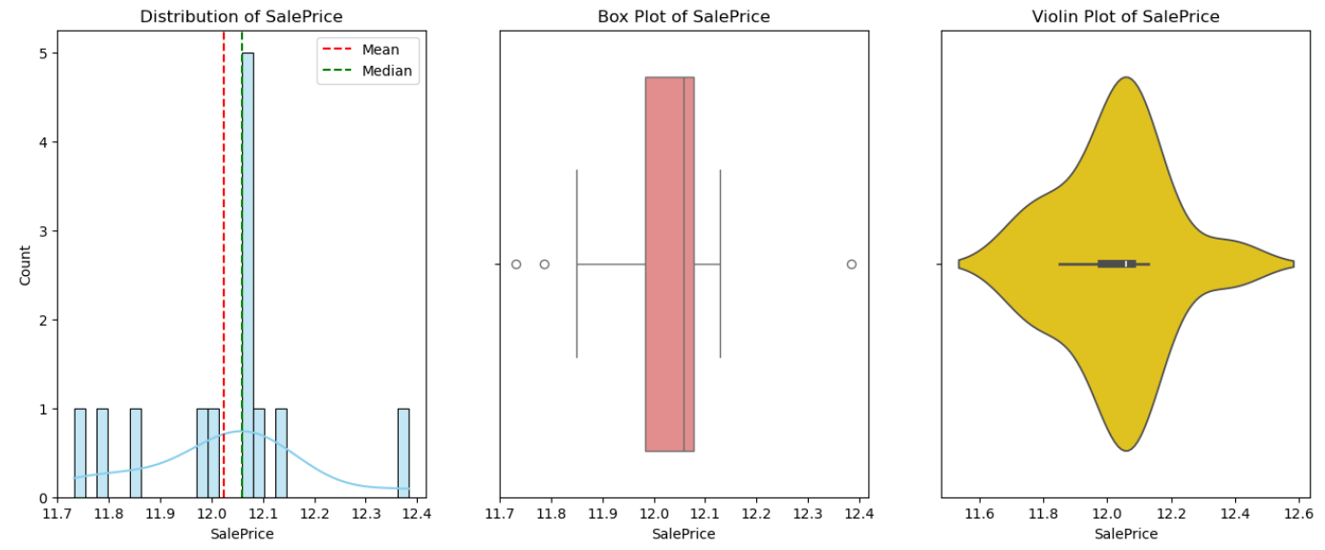
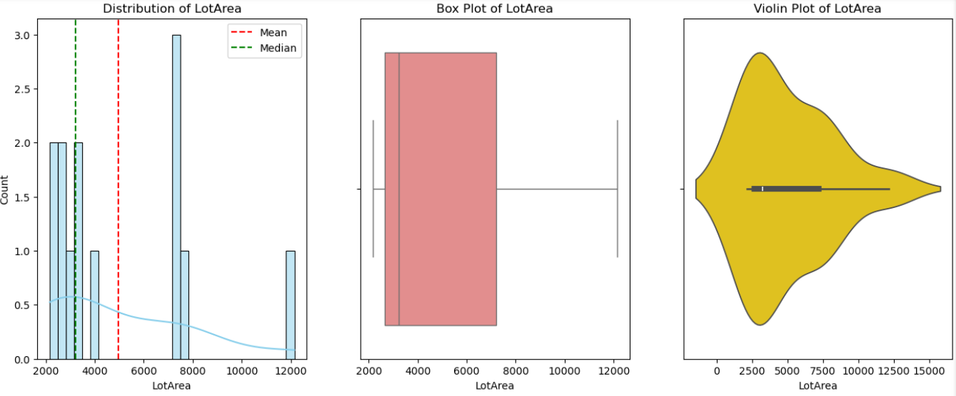
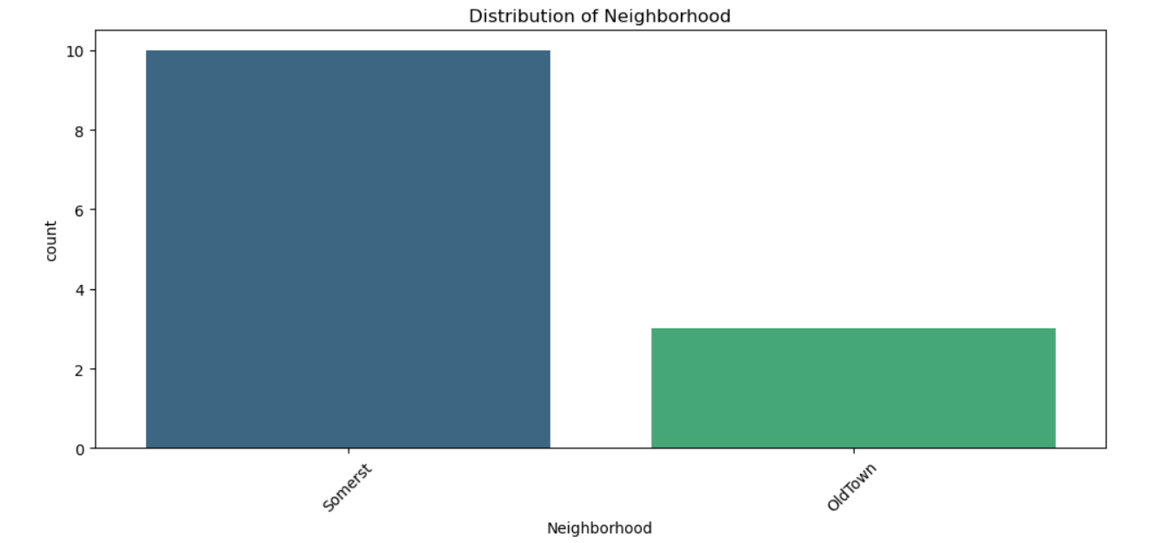
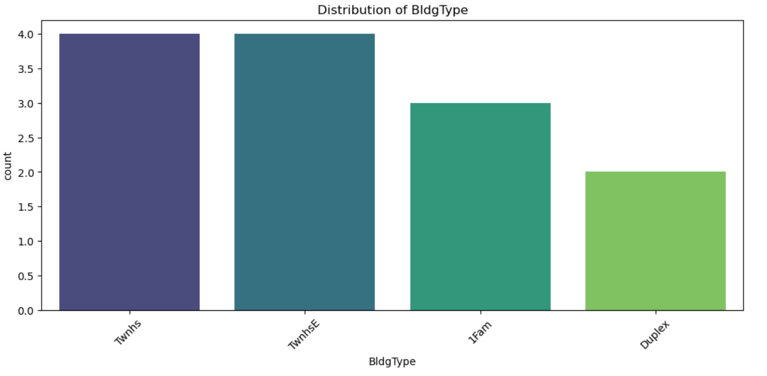
Univariate Analysis Visualizations

Slide 7
Multivariate Analysis
Objective:
Investigate relationships between multiple variables to understand how different factors influence house prices. This helps identify key drivers of property valuation.
Techniques Used:
Correlation Matrix:
Measures the strength and direction of relationships between variables.
Helps identify the most influential factors affecting house prices.
Scatterplots (e.g., Price vs. Square Footage):
Visualizes how property size impacts pricing.
Identifies linear or non-linear trends.
Insights:
Strong correlation between house price and square footage – larger homes tend to have higher prices.
Location plays a crucial role – properties in premium locations command higher prices.
Additional features (bedrooms, amenities) show moderate correlations with pricing trends.
Key Takeaway:
Multivariate analysis provides deeper insights into how size, location, and features impact real estate prices.
Helps in developing pricing models and investment strategies.

Slide 8
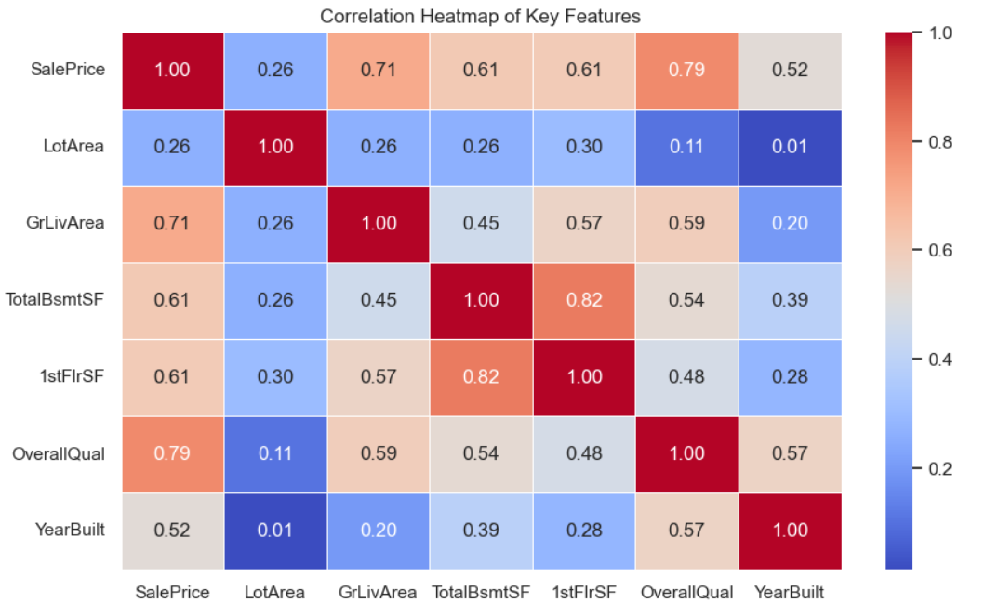
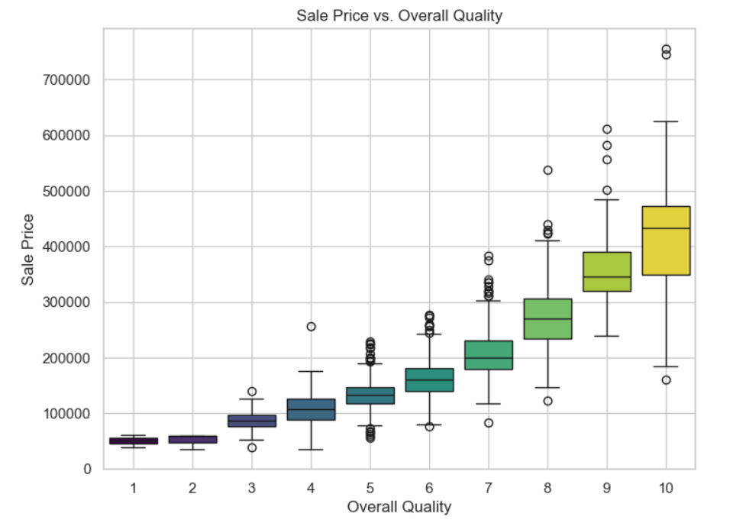
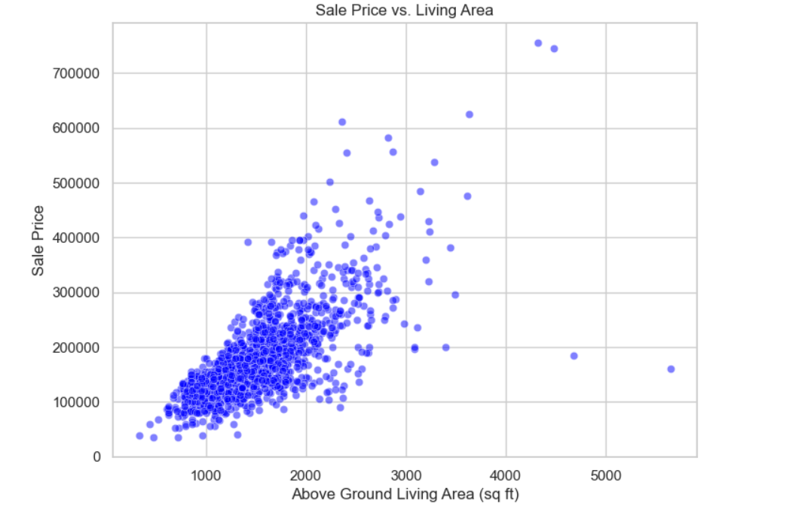
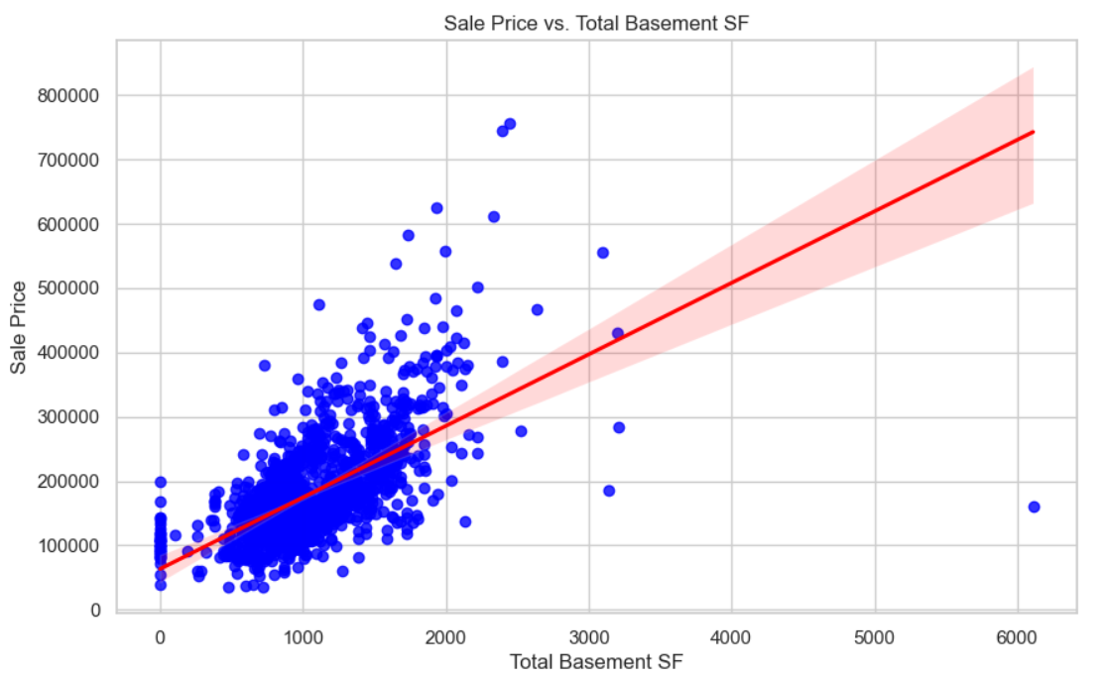
Multivariate Analysis Visualizations

Slide 9
Feature Engineering
Objective:
Enhance predictive power by creating new variables that provide deeper insights into real estate pricing. Feature engineering helps in making the dataset more informative for analysis.
Examples of New Features:
Price per Square Foot: Provides a standardized measure of property value.
Age of the Property: Helps assess depreciation and historical pricing trends.
Nearby Amenities Score: Quantifies the impact of schools, parks, and transport links.
Impact of Feature Engineering:
Improved Interpretability: Helps understand price variations in different areas.
Better Predictive Power: Enhances model accuracy by adding relevant features.
Deeper Insights: Allows segmentation based on affordability, investment potential, and market trends.
Key Takeaway:
Feature engineering unlocks hidden patterns in the dataset.
Custom features improve pricing analysis and market forecasting.

Slide 10
Size & Feature Impact on Price
Objective:
Analyze how property size and key features influence house prices, helping to determine the most valuable characteristics in real estate valuation.
Findings:
Larger Homes Generally Have Higher Prices
Square footage is one of the strongest indicators of price.
Price per square foot varies by location and amenities.
More Bedrooms & Bathrooms Contribute to Valuation
Properties with more bedrooms and bathrooms tend to have higher prices.
However, the increase in price is not always linear—diminishing returns exist.
Luxury Features Add Significant Value
Swimming pools, garages, and modern kitchens increase property appeal.
Homes with smart home technology, energy-efficient systems, or high-end interiors often sell at a premium.
Key Takeaway:
Size, number of rooms, and luxury amenities significantly influence real estate prices.
Buyers and sellers can leverage this information to strategically price or invest in properties.

Slide 11
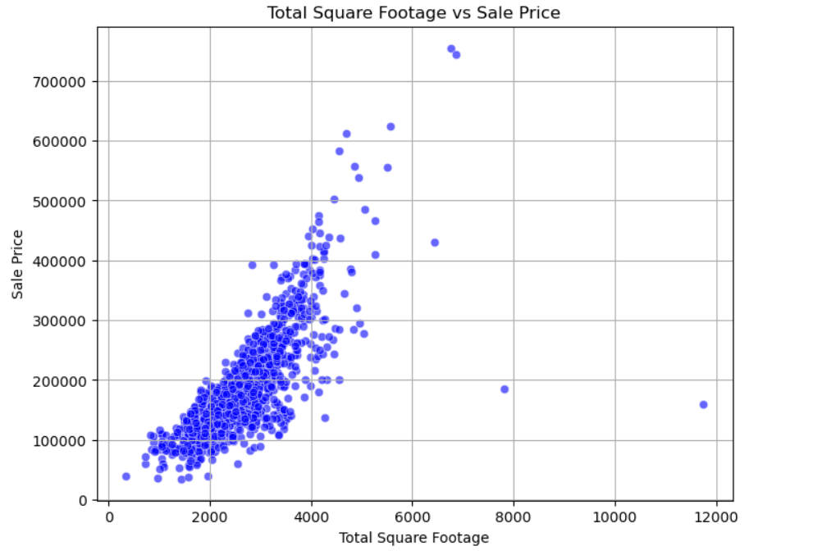
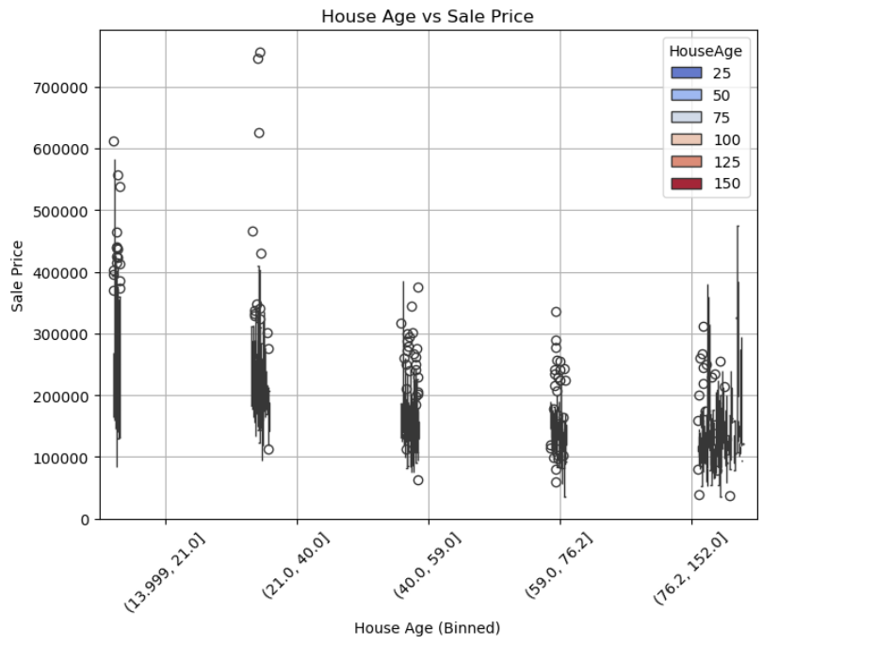
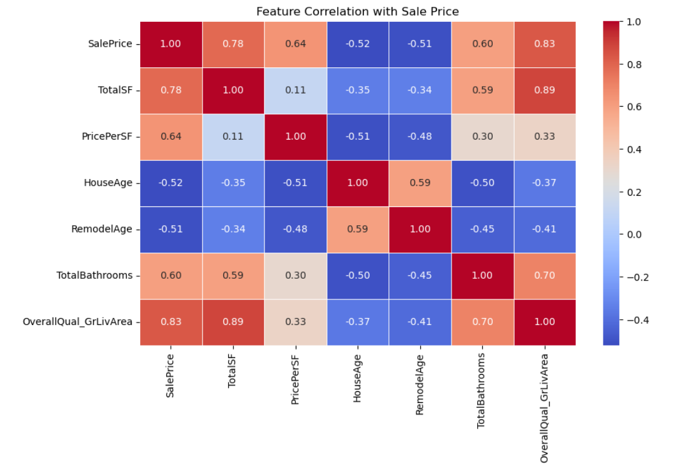
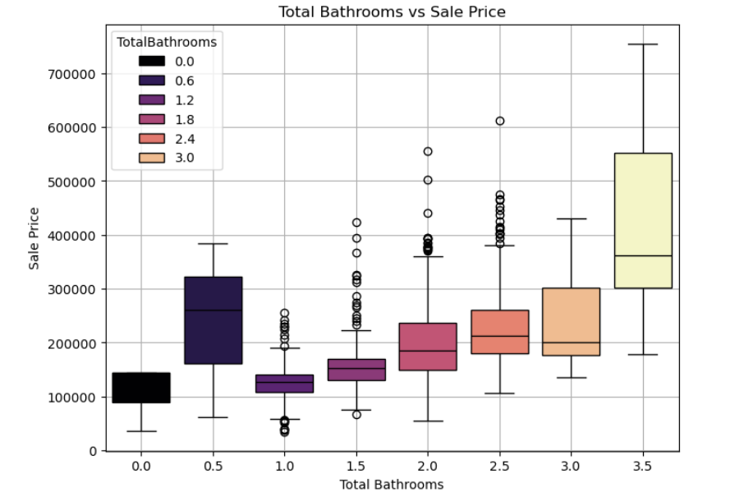
Visualize Feature Impact on House Prices

Slide 12
Market Trends & Historical Pricing
Objective:
Examine real estate price trends over time to identify patterns, market cycles, and external factors influencing property values.
Visualization Used:
Line Chart: House Prices Over Time
Displays how property prices have changed across different years.
Helps identify long-term trends and short-term fluctuations.
Insights:
Prices Fluctuated with Economic Conditions
Economic downturns (e.g., recessions, interest rate hikes) led to price drops.
Booming markets saw steady price increases due to high demand.
Seasonal Trends Observed in Pricing
Prices tend to rise in peak buying seasons (spring & summer).
Market slowdowns are common in winter months.
Key Takeaway:
Real estate prices are influenced by economic cycles and seasonal demand.
Understanding historical trends helps in forecasting future property values and investment decisions.

Slide 13
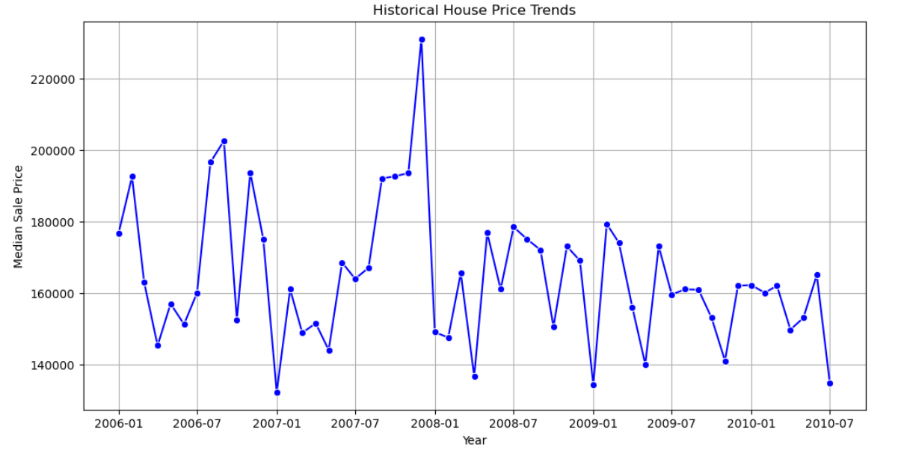
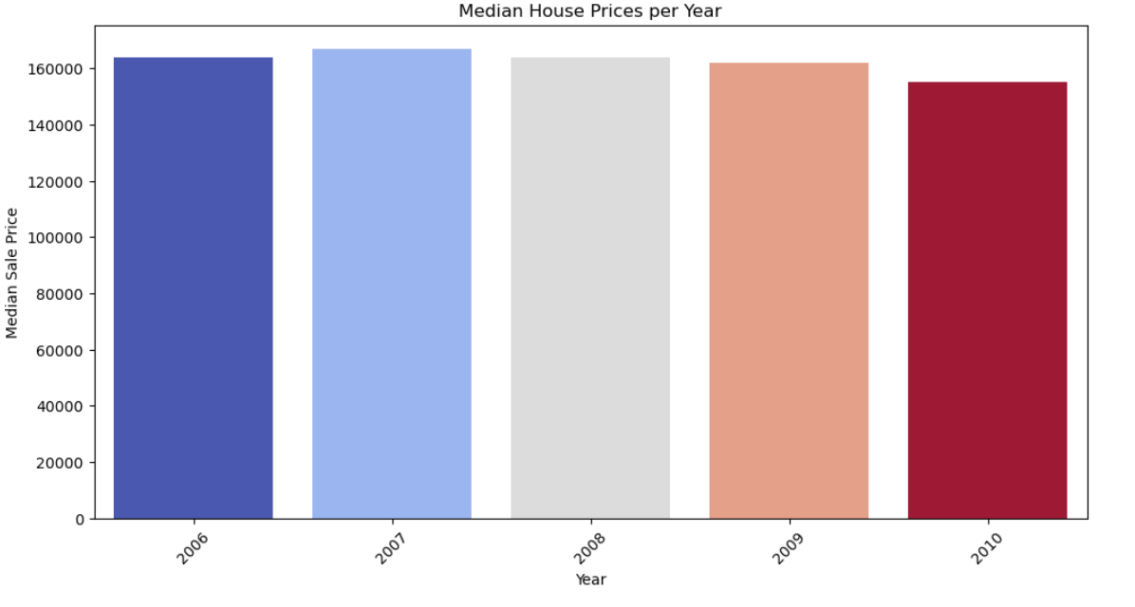
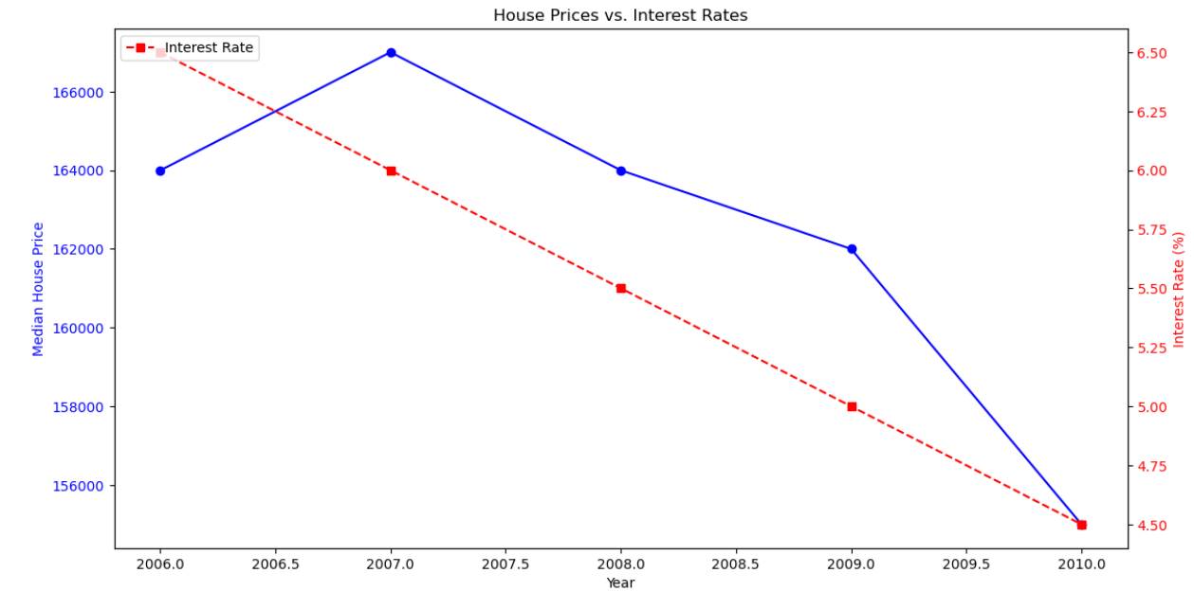
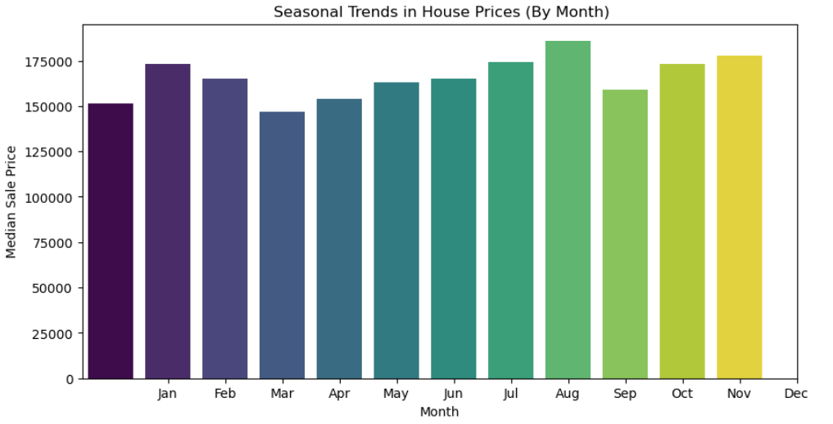
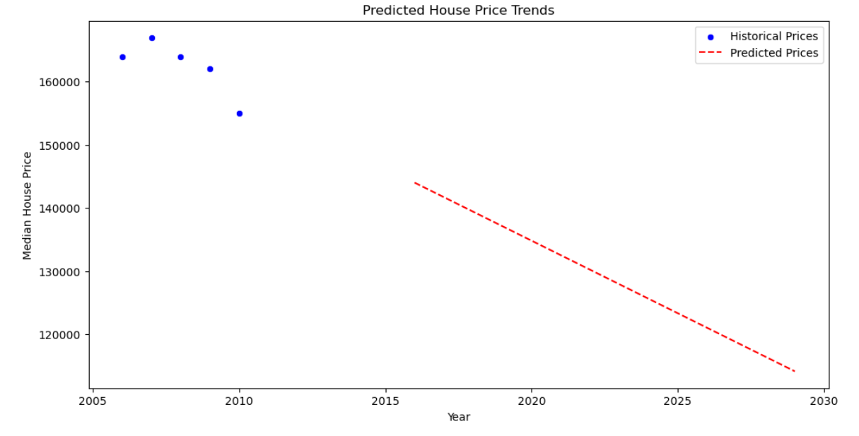
Analyze Price Trends Over Time

Slide 14
Customer Preferences & Amenities
Objective:
Assess how property features and neighborhood amenities influence real estate pricing.
Key Findings:
Luxury Amenities Increase Demand
Homes with garages, swimming pools, and modern kitchens are priced higher.
Energy-efficient and smart home features also add value.
Neighborhood Amenities Matter
Proximity to schools, parks, public transport, and shopping centers significantly affects valuation.
Properties in safe and well-developed areas command premium prices.
Key Takeaway:
Luxury and neighborhood amenities significantly shape buyer preferences and real estate valuation.
Developers and investors can leverage these insights to optimize pricing strategies.

Slide 15
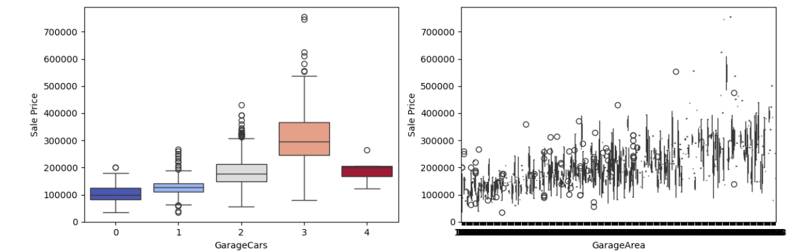
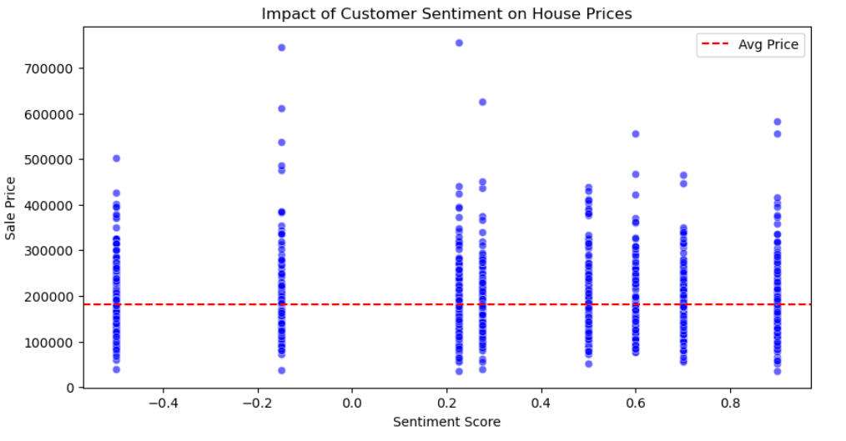
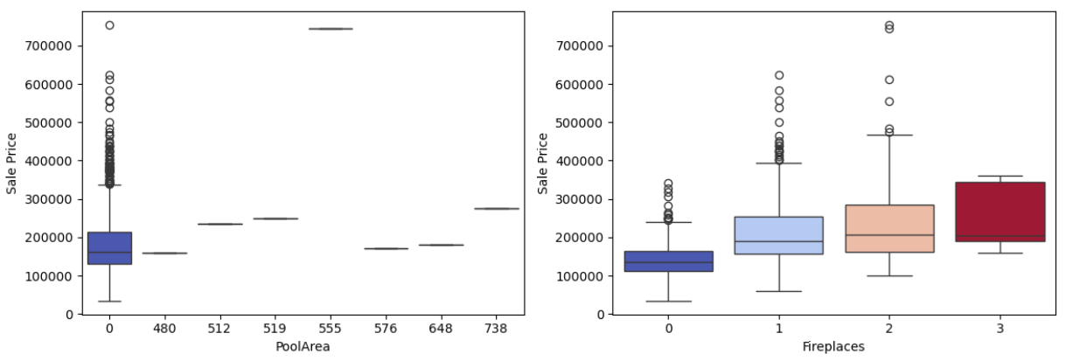
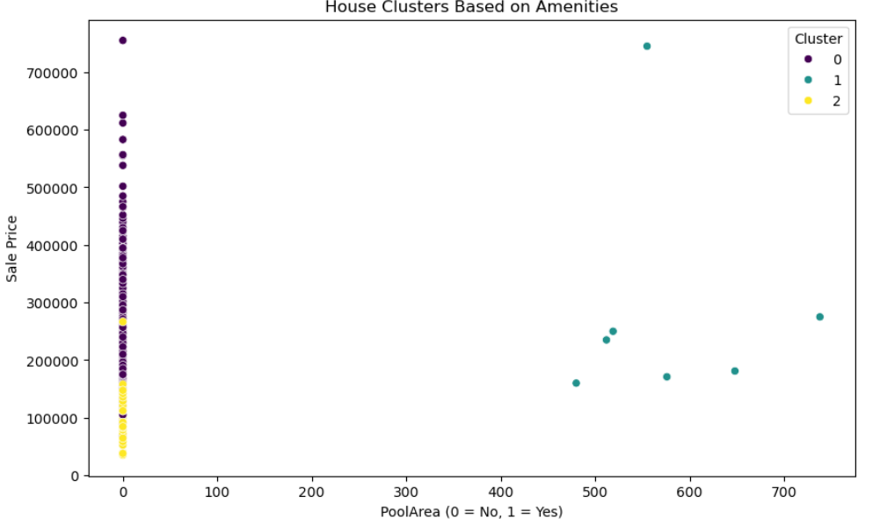
Visualizing the Impact of Amenities on House Prices

Slide 16
Challenges & Adjustments
Challenges Faced:
Missing Data in Older Records – Some historical property data lacked key features.
Outliers Affecting Analysis – Extreme property prices distorted trends.
Ensuring Meaningful Feature Selection – Some variables had weak correlations with price.
Adjustments Made:
Imputed Missing Values – Used median values and logical estimates.
Removed Extreme Outliers – Filtered properties with unrealistic prices or sizes.
Focused on Most Impactful Variables – Kept only strongly correlated features.
Key Takeaway:
Data preprocessing was essential to improve accuracy and reliability of insights.

Slide 17
Conclusion & Key Takeaways
Summary of Insights:
Size, Location, and Features Drive Home Prices – Larger homes in prime areas with premium amenities have higher valuations.
Market Trends Show Price Fluctuations Over Time – Economic conditions and seasonal trends impact pricing.
Customer Preferences Shape Real Estate Demand – Amenities and neighborhood features influence buyer decisions.
Final Takeaway : The analysis unveils key pricing drivers, helping buyers, sellers, and investors make data-driven decisions.

Slide 18
THANKS

